Slide 1
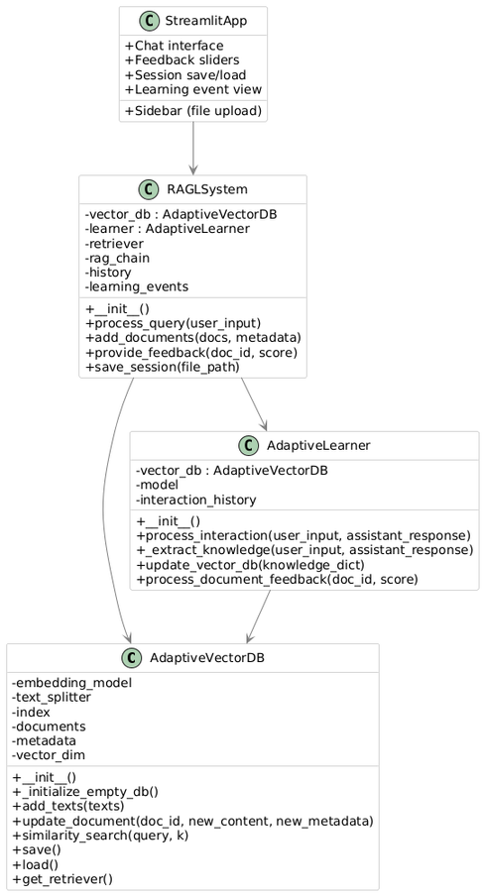
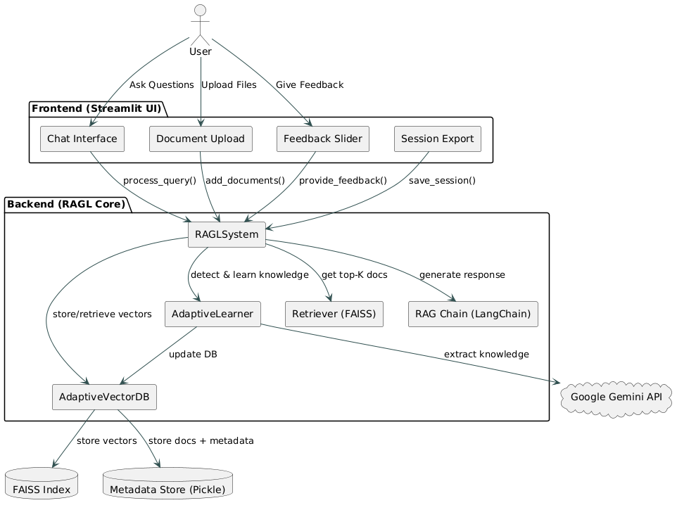
Adaptive Retrieval-Augmented Generation Learning (RAGL) System
Roll no.: 522263, 522261, 522136, 522252, 522237, 522227

